Slide 1

Architecture Choices That Impact Performance of Microsoft SQL Server

Slide 2

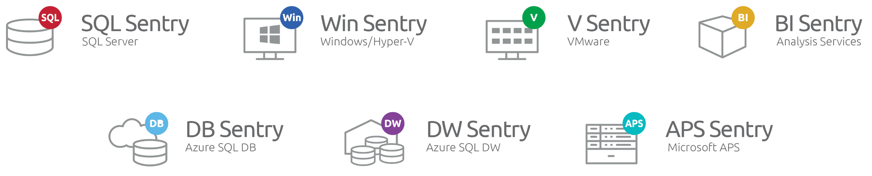
The One Platform for Physical, Virtual, and Cloud Performance.
SentryOne™ empowers Microsoft data professionals to monitor, diagnose, and optimize performance across physical, virtual, and cloud resources. The SentryOne platform delivers seamless integration for all of our solutions, enabling users to determine the true cause of performance issues, and reduce consumption and infrastructure costs.
http://SentryOne.com/BookADemo

Slide 3
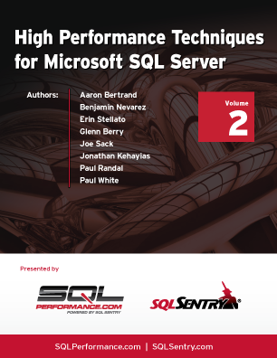
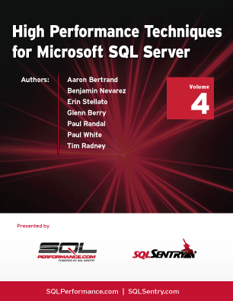
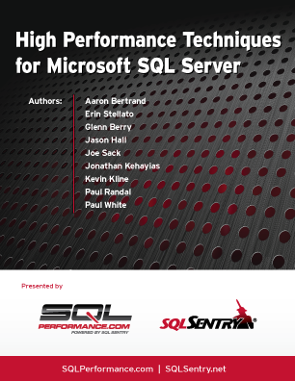
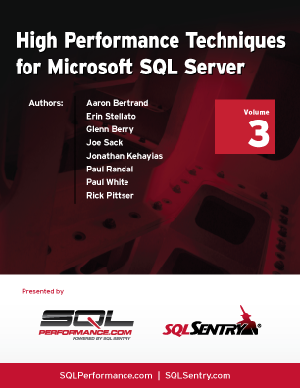
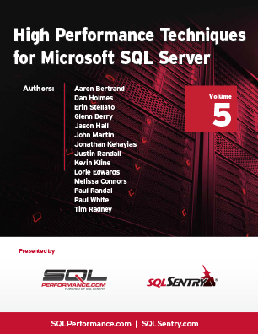
Free Resources
The One Platform for Physical, Virtual, and Cloud Performance.
Free e-books
In these books, you will find useful, hand-picked articles that will help give insight into some of your most vexing performance problems. These articles were written by several of the SQL Server industry's leading experts, including Aaron Bertrand, Paul White, Paul Randal, Jonathan Kehayias, Erin Stellato, Glenn Berry, and Joe Sack.
http://www.sentryone.com/ebooks/
Websites
SQLPerformance.com provides innovative and practical solutions for improving SQL Server performance.
Answers.SQLPerformance.com is a Q&A site where you can upload query plans directly from Plan Explorer and have questions answered from MVPs, staff, and expert Paul White.
SQLSentry.TV offers an inside look into the world of SentryOne with videos on query tuning and product demos.
Blogs.SentryOne.com is where you can find all of our team members’ blogs as well as important information about the latest updates to SentryOne software, SQL Server and server performance issues.

Slide 4





Your Presenter
Kevin Kline
Principal Program Manager, SentryOne
Microsoft Data Platform MVP since 2003
Contact Info
Email : KKline@SentryOne.com
Blog : http://blogs.SentryOne.com/author/kevinkline/
LinkedIn : https://www.linkedin.com/in/kekline/
Twitter : @Kekline

Slide 5
AGENDA
Introductions
Unexpected architectural choices that impact performance:
Quick overview of tables and indexes
Drawbacks of GUIDs
Full pages and performance
Performance surprises of concatenated indexes
Data type choices matter to performance
Constraints makes the optimizer better
Workload segregation
The WHY of normalization
Designing for concurrency
Special options for better performance
Summary and Q&A
Notes:
This session is mostly about under-appreciated design decisions that can have a negative impact on performance of a SQL Server database. We won’t be covering some common architectural topics like file placement, filegroups, etc.

Slide 6

Overview of Tables and Indexes
Three primary structures to remember tables with a clustered index (“heaps”), tables without a clustered index, and non-clustered indexes.
All three structures use an 8Kb data page (8192b total/ 8096 available) for storage:
Page header
Page header: Contains PageID, Next Page, Previous Page, amount of free space available, the object ID of owning object, status, and more. 96 bytes total.
Slot array tracks logical order of records
1 - Cooper
2 - Hofstadter
3 - Koothrappali
5 - Wolowitz
4 - Kripke
54
5
3
2
1
Graphic by Rich Douglas, @sqlrich, rdouglas@sentryone.com
Notes:
There are 128 pages stored in 1Mb of storage or memory.
By checking the header, SQL Server can quickly determine the status of each page, making it easily identifiable. For example, there’s a single bit in the header that marks whether a page is clean or dirty. Another bit in the header marks if the page has been backed up. That’s why, using these bits, SQL Server can be so fast with differential backups.

Slide 7
Heaps Versus Clustered
Heap
IAM
…
Leaf Pages
Root Page
Level 2
NCI
Intermediate Pages
Level 1
Index
Rows
Leaf
Leaf Pages
Level 0
…
…
…
Notes:
Heaps, have index_id of 0, Uses IAM and PFS to find the next place to put a record. Not optimised to find a single row, always scan.
No doubly-linked list.
Efficient for large serial data loads starting from empty
Inefficient for transaction processing: Can provoke forwarded record pointers, Forces an 8-byte RID for every inserted row (RID is file:page:slot)
Clustered index is a physically sorted table using a Binary Plus tree structure.
Contains non-leaf pages or “nodes” (Intermediate & Root in image) and leaf / data pages
Uses doubly linked lists – drive an optimization called read ahead – requests up to 512kb using lowest non-leaf level.
Note: Data is never returned from non-leaf level.
Primary means of exclusive locking on a table.
Non-clustered index is also a b-tree structure containing the clustered index data and a pointer row_id (for heaps) or clustered key (for clustered tables). Speed up SELECT statements, slow down write operations
The key and data is passed up the tree, unless the NCI is a unique nci whence it is stored at the leaf-level
Large and concatenated clustered indexes bloat ALL nci’s on a table.
Has at least one more intermediate level than the clustered index, but are much less valuable if table doesn’t have a clustered index.

Slide 8
Drawbacks of GUID vs. INT / BIGINT
Constant debate – use GUID or INT for clustering key?
 | INT / BIGINT | GUID | SEQUENTIAL GUID
Pros | Small Compresses well Fewer “bad” page splits | Globally unique* Minimal hotspots | Globally unique* Fewer “bad” page splits
Cons | Can cause hotspots IDENTITY/SEQUENCE issues on 2012+ Ascending key problem | Wide Compresses poorly Many “bad” page splits Heavy fragmentation Tough to troubleshoot | Wide Compresses poorly Causes hotspots Tough to troubleshoot
Trbl | OrderID = 42 | OrderID = ‘2C0C06E1-28A0-46BF-8CC6-63BC437AB42F’ | OrderID = 4212087341234
* I’m not convinced – we’ll run out eventually, right?
Notes:
Actually performance metrics of GUIDs versus INT/BIGINT at http://sqlperformance.com/2015/01/sql-indexes/bad-habits-disk-space. GUIDs caused 99% fragmentation in a regular OLTP workload vs about 2-3% for the other approaches, and nearly double the number of bad page splits.
Also note that in buffer pool space used, INT was least, followed by NEWID (sequential GUID), BIGINT, and finally GUID.
A good example of a poor clustering choice would be a uniqueidentifier, also known as a GUID. Uniqueidentifier columns are frequently encountered in database requirements, as GUIDs are a common and often beneficial data type in .NET applications. Uniqueidentifiers are an expensive pointer because they are typically not sequential and because they consume 16 bytes. One environment in which I’ve worked contained two tables, each with over a billion rows, clustered on a non-sequential uniqueidentifier, and 99.998% fragmented. By clustering instead on a bigint identity, I drastically reduced the time required for inserts. This also resulted in smaller indexes, saving over 100GB of disk space. In environments where the use of a uniqueidentifier is required, consider using an internal surrogate key, such as an int identity, as a clustering and foreign key to avoid the overhead and poor performance associated with GUIDs. Excerpt from http://sqlfool.com/content/PerformanceConsiderationsOfDataTypes.pdf.

Slide 9
Full Pages and Performance
During design, try to maximize the number of rows per page.
Determine row size = data type consumption + overhead bytes
Determine rows per page = 8096 / row size
Avoid:
MAX data types, where possible, especially on heaps
ONE BIG TABLE: Too many columns hanging on one primary key, usually 1st or 2nd normal form
Redundant data or malformed data, as evidenced by lots of calculations, datepart function calls, concatenations
Column stuffing:
Storing arrays (CSVs, XML, JSON to stuff multiple values into a single field)
Parsing and validation are very cumbersome.
Clustered indexes - narrow, static, unique, and ever-increasing columns
Notes:
MAX data types provoke implicit conversion issues when used as a search argument. FORWARDED RECORD POINTERS
In general, it is best practice to create a clustered index on narrow, static, unique, and ever-increasing columns. This is for numerous reasons. First, using an updateable column as the clustering key can be expensive, as updates to the key value could require the data to be moved to another page. This can result in slower writes and updates, and you can expect higher levels of fragmentation. Secondly, the clustered key value is used in non-clustered indexes as a pointer back into the leaf level of the clustered index. This means that the overhead of a wide clustered key is incurred in every index created.
If you don’t make your clustered index unique, it’ll have to add a 4-byte “unique-ifyer” to each row. But since it’s stored as a variable-length column it will actually consume 8-bytes of over head space. Creating a non-unique clustered index on a column with many duplicate values, perhaps on a column of date data type where you might have thousands of records with the same clustered key value, could result in a significant amount of internal overhead.

Slide 10
Full Pages With Heavy Write Performance
Root Page
Level 2
Upon index creation every page is 100% full leaving no empty space on the leaf or intermediate pages for added data from INSERT or UPDATE statements.
Default fill factor of 0/100 can cause costly page splits on some tables.
Promotes logical table fragmentation.
Fixes:
Specify FILL FACTOR option to leave open space in leaf pages
Specify PAD_INDEX option pushes fill factor up into intermediate pages
Intermediate Pages
Level 1
Leaf Pages
Level 0
Actual
place-
ment
Page
Split
DML
Remember:
Each write to leaf pages requires all non-clustered index structures to be updated!

Slide 11
Performance Surprises of Concatenated Indexes
Don’t forget that the clustered index is stored in EVERY non-clustered index! The shorter the index the less the I/O.
Remember that composite keys are most useful from the leftmost column to the rightmost column, in the order they appeared in the CREATE INDEX statement. Example:
Now, consider this index:
ALTER TABLE yellow_pages ADD CONSTRAINT [UPKCL_sales] PRIMARY KEY CLUSTERED ([lname], [fname], [street] )
LName
Linus
FName
Benjamin
Street
815 Oceanic
Hanso
Magnus
315 Ajira
Austin
Kate
1010 Madison
Notes:
Concatenated keys, also called composite keys, are evaluated from leftmost column to right (more on that later). So be sure the columns are indexed in order from most frequently used to least frequently used.

Slide 12
Using Concatenated Indexes
Works well with:
WHERE lname = @a AND fname = @b AND street = @c
Also works well with:
WHERE lname = @a AND fname = @b
How does the index work with this?
WHERE fname = @b OR title_id = @c
Best practice? Use a surrogate key for the primary key and then a natural key as a non-clustered index.
Tip - Don’t forget transitive properties!
Notes:
Also called composite indexes or composite keys.
SQL Server Index Design Guide:
https://technet.microsoft.com/en-us/library/jj835095(v=sql.110).aspx
---
Klaus shows how creating a recommended missing index does not help the query and adds overhead to the database anyway:
http://www.sqlpassion.at/archive/2015/01/20/how-i-tune-sql-server-queries/

Slide 13
Data Type Choices Matter to Performance
Illogical data type choices:
String and numeric types used for date or time data
Time in place of an interval
MONEY/FLOAT because they sound appropriate
TIMESTAMP because people think it involves date/time
SQL_VARIANT for anything
Space wasters (thus, I/O wasters):
Datetime when date or smalldatetime suffice
CHAR when VARCHAR is fine
MAX types for URL and e-mail address
INT for all numbers (INT is 4 bytes, SMALLINT is 2, TINYINT is 1)
Performance impediments:
NVARCHAR/NCHAR for columns that don’t need Unicode.
NOT NULL when the column shouldn’t be nullable
Storing CSV, XML, or JSON in a single generic text column
Destabilizers:
Not ensuring variables, parameters, or columns match in terms of data types and/or precision
Not ensuring join columns match in terms of data types and/or precision
Notes:
VARCHAR data type consumes only the amount of actual space used plus 2 bytes for overhead, compared to a CHAR. 6 In addition to the 2-byte offset per variable column, there is also a 2-byte overhead per row to maintain the count of variable columns. This is only incurred if one or more variable columns exist in the table.

Slide 14
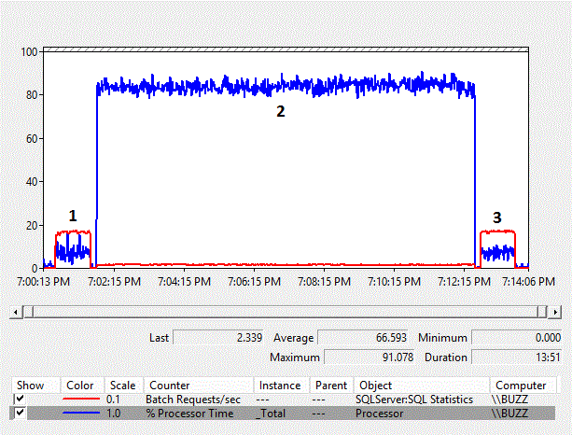
IMPLICIT CONVERSIONS
Lots of extra work when types don’t match
Batch requests/sec can go down, CPU can go WAY up, scans introduced
Jonathan Kehayias demonstrates that here with VARCHAR -> NVARCHAR
Happens all the time with data types in surprising places:
Between CHAR/VARCHAR and NVARCHAR data types
Between Numeric and INT data types
Between INTs and Character data types
WHERE ISNULL(MyField, 0) > 0
VARCHAR -> NVARCHAR
CPU from 7% to 84%
Batch Requests/sec from 165 to 15
Same batch from 1 min to 10 min
Notes:
Very useful data type conversion chart: http://bit.ly/15bDRRA
Data type precedence can also have an impact: http://bit.ly/13Zio1f
Ian Stirk’s Column Mismatch Utility at http://www.sqlservercentral.com/articles/Administration/65138/
Jonathan Kehayias’ plan cache analyzer at http://sqlblog.com/blogs/jonathan_kehayias/archive/2010/01/08/finding-implicit-column-conversions-in-the-plan-cache.aspx
--
Image note:
Jonathan Kehayias shows that just going from VARCHAR to NVARCHAR can slow performance by 10x or more.
Reference at http://www.sqlperformance.com/2013/04/t-sql-queries/implicit-conversion-costs

Slide 15
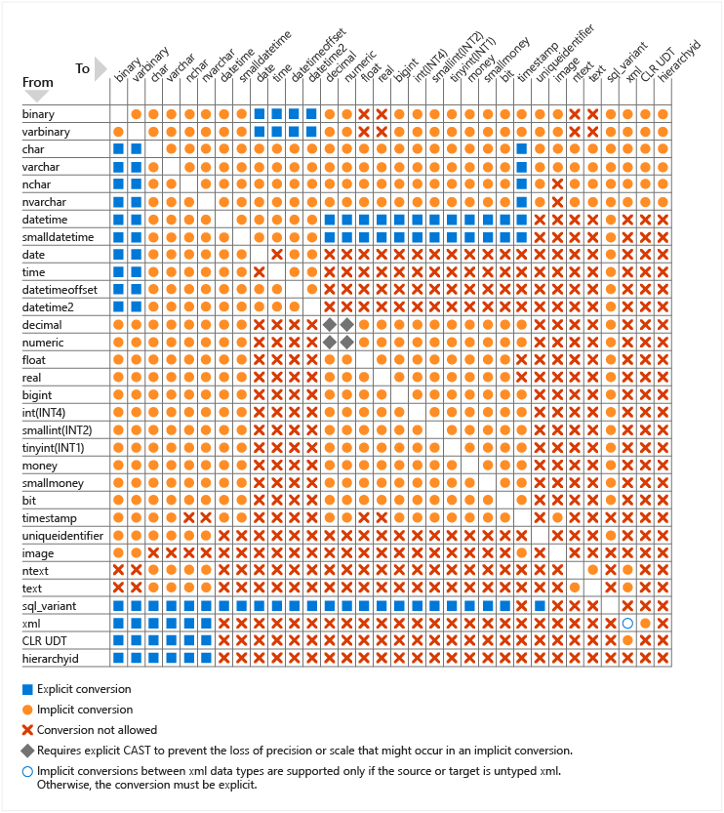
Data Type Compatibility Chart
Very useful data type conversion chart: http://bit.ly/15bDRRA
Data type precedence can also have an impact: http://bit.ly/13Zio1f

Slide 16
Constraints Make the Optimizer Better
Foreign keys do help performance, when they’re enabled and trusted!
Help eliminate unnecessary join operations
Not that you would write such bad queries, but your ORMs might
Provide the optimizer with better estimates
Don’t be jaded by people (devs?) who insist that referential integrity slows you down
Btw, please use schema prefixes…
Notes:
http://www.scarydba.com/2010/11/22/do-foreign-key-constraints-help-performance/
http://www.scarydba.com/2015/09/09/yes-foreign-keys-help-performance/
https://blogs.sentryone.com/aaronbertrand/bad-habits-semi-colons-schema-prefix/

Slide 17
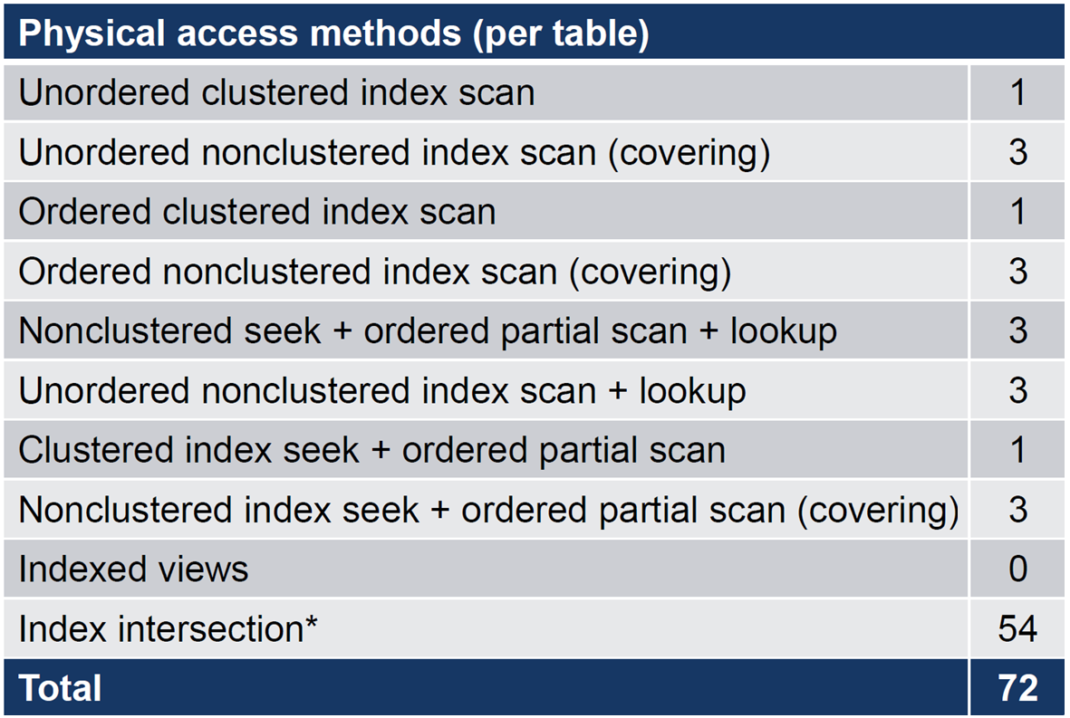
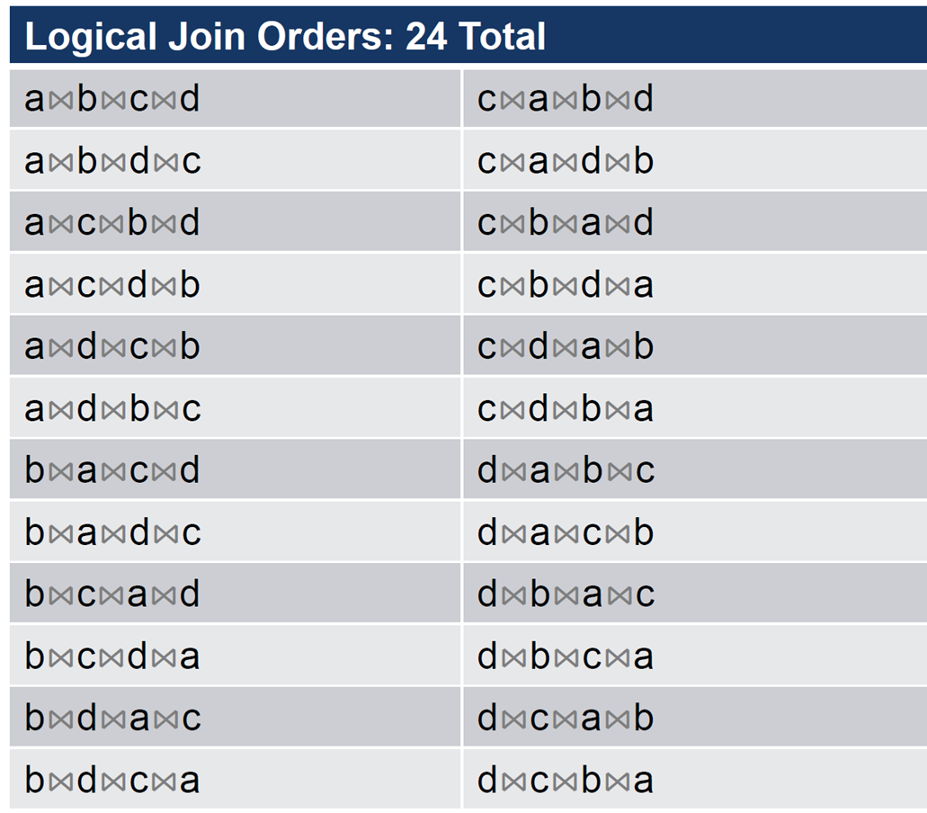
Optimal Plan vs Best Plan
The query optimizer seeks an optimal plan, not the best plan.
To find the best plan, the optimizer might have to assess every possible execution plan that achieves the directive of a given query.
Assume a, b, c, d are tables with a clustered index and 3 non-clustered indexes each.
How many physical access methods per table are available for this query?
Consider:
SELECT...
FROM a
JOIN b ON ...
JOIN c ON ...
JOIN d ON ...
72 Possible physical data access
methods
120 Possible logical join orders
Physical joins possible per
logical join
+ May require intermediate sort operation
--- --------------------------------
= 25,920 possible plans
Notes:
Script 10
6 combinations of 2 indexes; 1 join per pair = 6 joins; 3 join methods each = 18
6 combinations of 3 indexes; 2 joins per triplet = 12 joins; 3 join methods each = 36; total = 54
For really advanced users:
The sys.dm_exec_query_optimizer_info DMV includes a counter named “gain stage 0 to stage 1,” which shows the number of times search 1 was executed after search 0, and includes the average decrease in cost from one stage to the other, as defined by the following formula:
(MinimumPlanCost(search 0) – MinimumPlanCost(search 1)) / MinimumPlanCost(search 0)
Indicates improvement from phase to phase
Search 0 to 1 gain
Search 1 to 2 gain
Value that is >= 0 and < 1
0 indicates no improvement
Approaching 1 indicates significant improvement
Definition:
𝐺𝑎𝑖𝑛𝑆0𝑡𝑜𝑆1=𝑀𝑖𝑛𝐶𝑜𝑠𝑡(𝑆0)−𝑀𝑖𝑛𝐶𝑜𝑠𝑡(𝑆1)𝑀𝑖𝑛𝐶𝑜𝑠𝑡(𝑆0)

Slide 18
How Does the Optimizer Go So Fast?
Heuristic application of transformation algorithms speeds up SQL Server query optimization.
Based on relational algebra.
Alternatives are stored in memory structures called “Memos”.
Four transformation types:
Simplification
Exploration
Implementation
Physical Property Enforcement
Notes:
I like to say about SQL Server’s query plan selection “It might not be good, but it’s good enough”.
Another way to say this is “The goal of cost-based optimization is not to find the best possible physical execution plan by exploring every possible alternative; rather, the goal is to find a good plan quickly. This approach gives us an optimizer that works pretty well for most workloads, most of the time.”
We’ve already seen simplification. Let’s look at the other three.

Slide 19
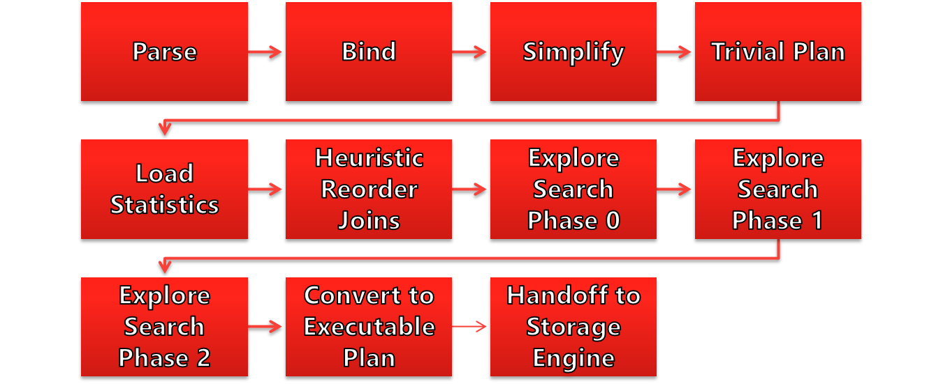
Steps in Query Processing
Notes:
Parsing and binding are the first operations performed when a query is submitted to a SQL Server instance. They produce a tree representation of the query, which is then sent to the query optimizer to perform the optimization process. At the beginning of this optimization process, this logical tree will be simplified, and the query optimizer will check whether the query qualifies for a trivial plan. If it does, a trivial execution plan is returned and the optimization process immediately ends. The parsing, binding, simplification, and trivial plan processes do not depend on the contents of the database (such as the data itself), but only on the database schema and query definition. Because of this, these processes also don’t use statistics, cost estimation, or cost-based decisions, all of which are only employed during the full optimization process.

Slide 20
Simplification
Make this query easier to process! Do things like standardize queries, remove redundancies.
For example:
Convert subqueries to joins; Convert inner join to outer join
Remove redundant joins, such as foreign key join elimination
Predicate pushdown
Contradiction detection
Aggregates on unique keys
Notes:
Graphic windows property, by pressing F4 on the plan operator, in SSMS execution plan will show TRIVIAL.
Showplan XML will show a StatementOptmLevel attribute as TRIVIAL.

Slide 21
Exploration Transformation
Start from a logical operation (may be a sub-branch of the full query)
Find equivalent logical operations, i.e. a substitute operation
Examples:
Join commutativity: A⋈B ➔ B⋈A
Join associativity: (A⋈B)⋈C ➔ A⋈(B⋈C)
Aggregate before join
Notes:
It’s important to remember that applying rules does not necessarily reduce the cost of the generated alternatives, and the costing component still needs to estimate their costs. Although both logical and physical alternatives are kept in the Memo structure, only the physical alternatives have their costs determined. It’s important, then, to bear in mind that although these alternatives may be equivalent and return the same results, their physical implementations may have very different costs.

Slide 22
Implementation Transformation
Start from a logical operation
Find equivalent physical operation
Examples:
A⋈B ➔ A (nested loops join) B
A⋈B ➔ A (merge join) B
A⋈B ➔ A (hash join) B
Obtain costing on physical operations
Can prune expensive branches from tree

Slide 23
Physical Property Enforcement Transformation
Properties associated with parse tree nodes
Uniqueness, type, nullability, sort order
Constraints on column values
Transformation rules may cause certain properties to be enforced
Example: sort order for a merge join

Slide 24


Workload Segregation
Sales
Databases
Data
Log
Reports
Tables
Cust
Ndx
Emp
Sales
Prod
Ndx
Ndx
Ndx
Ndx
Ndx
Indexes
Notes:
Click #1: The first two rules of SQL Server storage tuning are:
A) Make sure you have enough memory or else your IO will get thrashed.
B) Segregation of disparate IO workloads
Click #2: The most elementary rule of segregating IO workloads on SQL Server is to put the Data file and the Transaction Log file on to separate disks … or for even better speed … CLICK #3 … you can use disk arrays with lots of spindles. The more spindles and the higher the RPM speed of the spindles, the faster the IO.
Click #4: But often, having lots of competing queries and transactions within the database means that the hard disk armatures are flying all over the place, reading from one table, writing on another table non-stop. In a sense, distinct areas within your database application are competing for the IO resources on the disk array. So a great way to ensure that adequate IO is available for important, but distinct parts of the database application, is to create separate files for those groups of tables and indexes putting them on their own files. For example, the regular Sales database might be primarily a randomized read-write workload where sales people and customers are inserting sales orders through the web interface. At the same time, executive management might want to pull big reports that query across Mbytes or Gbytes of data at once – basically, a contradictory workload to what the sales people and web customers are doing. So to avert a shortage of IO resources, we can create additional files on additional disks.
In fact, if you a multi-core SQL Server, you should probably start with four data files for your tempdb and user database so that SQL Server can take advantage of multi-core access to the data. Ad hoc discussion here…
Click #5: We can also do lots of tuning at the table and index level. For example, adding indexes to better support our queries and join operations, while consuming a little extra space, can speed up the queries enormously. We can split tables into partitions, so that old and infrequently accessed data is stored onto a different disk array so that our fastest arrays can be used for our most frequently accessed data. We can use techniques like fill factor and clustered indexes to control how SQL Server writes data at the lowest level, 8 Kbyte pages, and influence how many records are locked per transaction.

Slide 25
The WHY of Normalization
A design technique that minimizes programming and data quality problems:
Insert-Update-Delete anomalies
Reduces redundant data.
Organizes data so that future changes to tables are easier
Ensure data quality throughout data manipulation operations
Performance and efficiency? Incidentally, but not directly.
Characterized by levels of adherence called normal forms:
Spans levels 1 through 5, but most apps only need up to 3NF
Read-heavy BI workloads often require denormalization
Notes:
So what's normalization used for? Normalization is a design technique that enables database designers and programmers to develop table structures that minimize programming problems. As we discuss normalization, we'll show you each set of problems that a particular kind of normalization helps negate.
The process of normalization is characterized by levels of adherence called normal form. If a table design conforms only to the lowest level of normalization, it is said to be in first normal form which is abbreviated as 1NF. If a table design conforms to the next higher level, it is in second normal form (2NF), and so on. It is uncommon and probably never necessary to take a table design beyond third normal form (3NF). In fact, in some cases, it is actually advantageous in terms of performance to denormalize a table from a higher normal form back to a lower normal form, like from 3NF to 2NF. It is also important to remember that normalizing tables is not full database design, rather it is an important step in the analysis process. The database design process is detailed more fully in Chapter 2.
Insert Problem: Suppose that a chimpanzee has been acquired and has to be added to the table. It would be impossible to add the new chimp without also adding a trick. Conversely, a new trick couldn't be added to the database without also assigning the trick to a circus animal, which might not reflect the actual business rule.
Delete Problem: What happens if a trick is deleted from the table? Unfortunately, important data about a circus animal would also be deleted. The situation also falters when an animal is deleted, erasing information about a trick that may still be used by the circus.
Update Problems: Updates in the unnormalized table could cause actions on multiple records. Great care must be taken to properly identify the appropriate record when making a change.

Slide 26

Unnormalized Data
Circus_Info Table
animal_nbr (the primary key)
animal_name
tent_nbr
tent_name
tent_location
handler_name
trick_nbr1
trick_name1
trick_learned_at1
trick_skill_level1
trick_nbr2 (...16)
trick_name2 (...16)
trick_learned_at2 (...16)
trick_skill_level2 (...16)
Insert problems!
Delete problems!
Update problems!
To achieve 1NF, we must separate repeating groups.
Notes:
In this example, the animal_nbr column (in boldface) is our primary key, or the value that uniquely identifies each row. This is an unnormalized structure. But why go to the trouble of normalizing it? Well, otherwise, there would be a number of logical anomalies to deal with. In fact, there would be logic faults whenever you attempted insert, delete, or update operations on this table. (Similar problems are resolved each time you apply a higher level of normalization). The reason there are so many problems with this table design ist that much of the data is redundant and does not wholly depend on the key of the table (animal_nbr).
Insert Problem: Suppose that a chimpanzee has been acquired and has to be added to the table. It would be impossible to add the new chimp without also adding a trick. Conversely, a new trick couldn't be added to the database without also assigning the trick to a circus animal, which might not reflect the actual business rule.
Delete Problem: What happens if a trick is deleted from the table? Unfortunately, important data about a circus animal would also be deleted. The situation also falters when an animal is deleted, erasing information about a trick that may still be used by the circus.
Update Problems: Updates in the unnormalized table could cause actions on multiple records. Great care must be taken to properly identify the appropriate record when making a change.
Now to put this in 1st Normal Form (1NF) we must eliminate repeating groups. That means that any subgroups of data that appear within the record should be stripped out into separate tables. In this case, we have at least two major repeating groups to split into separate tables. Thus, our unnormallized structure becomes two tables in 1NF.

Slide 27

1NF Data
Circus_Animals Table
animal_nbr (the primary key)
animal_name
tent_nbr
tent_name
tent_location
Insert problems!
Delete problems!
Update problems!
Tricks Table
animal_nbr (the concatenated key)
trick_nbr (the concatenated key)
trick_name
trick_learned_at
trick_skill_level
To achieve 2NF, we must separate partial dependencies.
Notes:
Advantages?
Now that our tables are in 1NF, we have the obvious advantage of reduced space consumption. Plus, an animal that only knows a few tricks doesn't use up the space allotted for 16 tricks in the unnormalized table. On the flip side, the animal can also know more than 16 tricks. Also note that in the Tricks table, the key had to be expanded to include both the animal_nbr and trick_nbr.
Concatenated keys are often the by-product of the normalization process.
Second Normal Form (2NF)
Let's make take our 1NF circus tables to 2NF by eliminating partial dependencies. Say what? A partial dependency is a fancy word for data that doesn't depend on the primary key of the table to uniquely identify it. For example, the trick name appears in every animal record, but the trick_nbr should be sufficient since we've already got the name in the TRICKS table.
So this 1NF table:
Tricks Table
animal_nbr
trick_nbr
trick_name
trick_learned_at
trick_skill_level
Becomes these 2NF tables:
Tricks Table
trick_nbr
trick_name
Animal_Tricks Table
animal_nbr
trick_nbr
trick_learned_at
trick_skill_level
Animal Table in 2NF
animal_nbr
animal_name
tent_nbr
tent_name
tent_location
Unfortunately 2NF, as 1NF, has its own logical faults when attempting data manipulation.
Insert Problem: Assume that we want to create a new record to represent a tiger assigned to the "Big Cats" tent. It's impossible to create an additional tiger's record for the Animals table without first creating a new tent. This is due to the fact the tent_nbr has a transitive dependency to the animal_nbr column, which more uniquely identifies their information than does the tent_nbr column.
Delete Problem: Deleting a particular animal might result in the loss of an entire tent, even though you still want to retain information about that tent. For example, deleting the sole ostrich in the circus complete removes all traces of the "Big Birds" tent, since you only have one of these large birds.
Update Problem: Tent information is redundant in the Animals table, so any change to tent information require a search of the entire table to locate the records needing alteration. Plus, the number of the records requiring the update may vary over time.
An additional step of normalization is needed to eliminate these logic faults. This added step converts a 2NF table into a 3NF table.

Slide 28

2NF Data
Tricks Table
trick_nbr
trick_name
Animal_Tricks Table
animal_nbr
trick_nbr
trick_learned_at
trick_skill_level
Insert problems!
Delete problems!
Update problems!
Animal Table
animal_nbr
animal_name
tent_nbr
tent_name
tent_location
To achieve 3NF, we must separate transitive (i.e., hidden) dependencies.
Notes:
Second Normal Form (2NF)
Let's make take our 1NF circus tables to 2NF by eliminating partial dependencies. Say what? A partial dependency is a fancy word for data that doesn't depend on the primary key of the table to uniquely identify it. For example, the trick name appears in every animal record, but the trick_nbr should be sufficient since we've already got the name in the TRICKS table.
So this 1NF table:
Tricks Table
animal_nbr
trick_nbr
trick_name
trick_learned_at
trick_skill_level
Becomes these 2NF tables:
Tricks Table
trick_nbr
trick_name
Animal_Tricks Table
animal_nbr
trick_nbr
trick_learned_at
trick_skill_level
Animal Table in 2NF
animal_nbr
animal_name
tent_nbr
tent_name
tent_location
Unfortunately 2NF, as 1NF, has its own logical faults when attempting data manipulation.
Insert Problem: Assume that we want to create a new record to represent a tiger assigned to the "Big Cats" tent. It's impossible to create an additional tiger's record for the Animals table without first creating a new tent. This is due to the fact the tent_nbr has a transitive dependency to the animal_nbr column, which more uniquely identifies their information than does the tent_nbr column.
Delete Problem: Deleting a particular animal might result in the loss of an entire tent, even though you still want to retain information about that tent. For example, deleting the sole ostrich in the circus complete removes all traces of the "Big Birds" tent, since you only have one of these large birds.
Update Problem: Tent information is redundant in the Animals table, so any change to tent information require a search of the entire table to locate the records needing alteration. Plus, the number of the records requiring the update may vary over time.
An additional step of normalization is needed to eliminate these logic faults. This added step converts a 2NF table into a 3NF table.

Slide 29

3NF Data
Tricks Table
trick_nbr
trick_name
Animal_Tricks Table
animal_nbr
trick_nbr
trick_learned_at
trick_skill_level
Each column of a 3NF table should provide a single-value fact about the key, using the whole key (if concatenated), and nothing but the key to derive its uniqueness.
Animal Table
animal_nbr
animal_name
tent_nbr
Animal Table
tent_nbr
tent_name
tent_location
Notes:
Third Normal Form (3NF)
To take this motley crew of tables to 3NF, we must now take 2NF tables and eliminate all transitive (i.e., hidden) dependencies. In other words, every column that isn't a part of the key must depend on the key for its informational value. Non-key columns should have no informational value if they are separated from the key of a 3NF table. Remember that the term 'eliminate' doesn't mean to delete. Instead it means to split into separate tables.
Our tables in 3NF would now look like:
Tricks Table (unchanged, it was already 3NF!)
trick_nbr
trick_name
Animal_Tricks Table (unchanged, it was already 3NF!)
animal_nbr
trick_nbr
trick_learned_at
trick_skill_level
The Animals table becomes two new 3NF tables:
Animal_Lodging Table in 3NF
animal_nbr
animal_name
tent_nbr
Tents Table in 3NF
tent_nbr
tent_name
tent_location
2NF and 3NF are all about the relationship between non-key and key fields. A 3NF table should provide a single-value fact about the key, use the whole key (if concatenated), and nothing but the key to derive its uniqueness.
By the time you get to 2NF, the columns all depend on the primary key for their identity. However, the columns may have such a distinction from other columns in the table that they should be split out into a separate table. In the Animal_Lodging table, the tent_nbr still appears as a non-key column in the table, even though it is the primary key of the Tents table. Thus, tent_nbr is a foreign key within the Animal_Lodging table. Using tent_nbr as a foreign key, we are able to join the data together from the two separate tables to form a single dataset.

Slide 30
Recap of Normalization
Normalization:
Reduces redundant data.
Organizes data so that future changes to tables are easier.
Ensure data quality throughout data manipulation operations.
1NF tables:
Contain no repeating fields.
2NF tables:
Are 1NF, plus…
Have a multiple-field primary key, but each non-key field relates to all of the fields making up the primary key.
3NF tables:
Are 2NF, plus…
Have a single-field primary key and requires that each non-key field be a direct description of the primary key field.
Denormalization:
Improves performance by reducing joins, as well as simplified data retrieval and manipulation.
Lessens tempdb usage and decreases calculations and aggregations needed for summary reports.
Consumes more storage space.
Typically used for reporting and BI, but not in transaction-processing systems.
Notes:
To Summarize: Normalizing data means eliminating redundant information from a table and organizing the data so that future changes to the table are easier. A table is in first normal form (1NF) when each field contains the smallest meaningful data and the table contains no repeating fields. Second normal form (2NF) refers only to tables with a multiple-field primary key. Each non-key field should relate to all of the fields making up the primary key. Third normal form refers only to tables with a single-key field and requires that each non-key field be a direct description of the primary key field. For most types of applications the normalization is now complete; we now have many stable tables with relatively few columns. The 3NF tables are now free of the anomalies that vex 2NF, 1NF, and unnormalized tables - meaning that data can be freely inserted, updated, or deleted in any of the tables without affecting any other table. Redundant data has been greatly reduced. Furthermore, updates now only act against a single row of each table. The steps described here are merely guidelines that help you design a set of stable table structures.
Beyond 3NF?
There are additional steps in normalization used to solve other specific logic faults in table design; however, they are seldom practical in the use of nonacademic applications. Read on for a quick glimpse of normal forms beyond 3NF:
Boyce-Codd Normal Form (BCNF): Ensures that absolutely no hidden dependencies exist by splitting off tables if determinate columns exist in a 3NF table. A determinate is a column that some other column is fully functionally dependent on. This would be akin to splitting the store_dept table into two tables; one called store_dept that contained only store_nbr and dept_id, and the other table called dept_name which contained only dept_id and dept_name.
Forth Normal Form (4NF): Compensates for multivalued dependencies in a three-column table (of A, B, and C), where columns A and B have a well-defined relationship and columns A and C have a well-defined relationship, but columns B and C are completely independent.
Fifth Normal Form (5NF): Almost a purely academic exercise, 5NF offsets join and projection dependencies that cause spurious results, hence it’s occasionally used name of Join-Projection Normal Form.
Domain-Key Normal Form (DK/NF): Donald Fagin introduced the idea of DK/NF back in 1981. It solves most insertion and deletion logic faults, and it provides generic definitions of deriving normal forms. However, no methodology or standardized algorithm exists for deriving DK/NF.
Denormalization
You’ve just read all about how and why to normalize tables. Designing table structures to 3NF reduces data redundancy and provides clean, logical table structures. But now we’re going to tell you all the reasons to denormalize tables. Odd as this might sound, denormalization is not diametrically opposed to normalization though some purists might testify otherwise.
The main benefit of denormalization is improved performance, although simplified data retrieval and manipulation is sometimes a lesser benefit. Both of these benefits are rendered through the reduction in the number of joins needed for the proper functionality of your application. Joins (described in Chapter 3) merge the data of two related tables into a single result set, presenting a denormalized view of the data. Joins, however, are rather time consuming and utilize a lot of CPU cycles. So, to reduce the expense of joins, many developers preempt what would otherwise be a very common join with a denormalized table. The table is now exposed to the vulnerabilities inherent in its lower normal form, but considerable time is saved because the application no longer has to join multiple tables together in a temporary workspace. Denormalization can also save processing time that might have been spent on the creation of summary reports.
The first thing you need to remember about denormalization is that you must thoroughly understand the needs and behavior of the data. There are some other tips to keep in mind when considering denormalizing tables:
Denormalization means that more storage space will be needed for the redundant data.
Redundant data usually speeds up queries, but can slow down updates since multiple instances of the data item must be altered.
Denormalized tables can introduce logic faults that must be compensated for in the application code.
Maintaining integrity can be more difficult with redundant data.
Denormalization yields the best improvements on tables that are frequently queried, such as validation tables or reporting tables. Tables where records are frequently inserted, updated, and deleted are less viable candidates for denormalization.
Denormalization is generally regarded as a tuning method of last resort by the purists. On the other hand, we working DBAs feel that it is perfectly natural to denormalize a frequently used eight-way join to create a simpler three-way join, for example. Denormalization is usually accomplished by adding columns and foreign keys from other tables into the denormalized table or by adding aggregate columns to the denormalized table. If every query issued against a given table commonly has to join to columns from one or more other tables, you’re looking at a candidate for denormalization.
I assume that we will compile a list of references (books, periodicals) later on. But if you are using some material while you write, it may be a good idea to include references right away.
I wouldn’t say that it’s the last resort. Very often it’s only natural to denormalize and get some redundant data but replace an 8-table join with a 2-table join.
-Hopefully, I answered comment properly. KK-

Slide 31
Designing for Concurrency
Blocking and Deadlocking:
SQL Server issues locks according to the type of indexes available and the kind of transaction. The locks are held until the transaction is complete.
Whether and where you put indexes matters a lot for locking!
It may start at row- or page-level locking, then escalate to a full table lock.
Uses a mix of shared and exclusive locks to get work done quickly.
Versionstore: Great for when writers are blocking readers.
Implemented using READ COMMITTED SNAPSHOT ISOLATION
Uses bargeloads more tempdb
Forces data pages to store 14-bytes for the versionstored_id per row in the user datebase, older versions can have longer chains (more scanning)
Consumes more memory, I/O, and CPU for updates and deletes
Notes:
LOCKING and BLOCKING
clust
VERSIONSTORE
Update performance can be slower due to the work involved in maintaining row versions. In typical OLTP workloads, each update changes just a few rows in a database. In these systems, the performance for updates in a database where the options are ON may be only a few percentage points slower compared to databases with both options OFF. The performance cost of versioned updates could be higher when larger amounts of data change during update operations.
Data readers face the extra cost of traversing the version link list. The older the snapshot, the slower the process of accessing it in a snapshot isolation transaction.
Snapshot isolation is also vulnerable to a somewhat-related phenomenon known as write skew. Reading state data plays a part in this, but this issue also helps clarify what snapshot 'write conflict detection' does and does not do. Write skew occurs when two concurrent transactions each read data that the other transaction modifies. No write conflict occurs because the two transactions modify different rows. Neither transaction sees the changes made by the other, because both are reading from a point in time before those changes were made.

Slide 32
Special Options for Better Performance
Columnstore:
Ideal for massive tables of 1M+ records in read-heavy workloads
Excels in scenarios with aggregated results, multi-table joins (esp star and snowflake schemas), single-column joins between columnstore indexed table to other tables
Often 4x to 14x faster. Much smaller consumption of disk and memory
In-Memory OLTP (a.k.a “Hekaton”)
A completely new set of internals and architecture
On greenfield applications, can return 16x to 40x speed improvements
Data compression:
A physical implementation at page- and/or row-level
Reduces I/O and memory consumption significantly*
Slight increase in CPU**
Notes:
Data Compression - http://blogs.sqlsentry.com/melissaconnors/sql-sentry-data-compression-3
*Under most OLTP workloads, where reads improve by 40-60% but UPDATE statements receive the least benefit or even degrade
**Upon initial compression, CPU can jump up by 20% or more but is then on 1-3% under most workloads

Slide 33
Rowstore Tables
C1 C2
C1 C2
8K
Pages
C1 C2
C1 C2
C1 C2
C1 C2
C1 C2
C1 C2
C1 C2
C1 C2
C1 C2
C1 C2
C1 C2
C1 C2
C1 C2
C1 C2
C1 C2
C1 C2
Leaf
Level
C1 C2
C1 C2
C1 C2
C1 C2
C1 C2
C1 C2
…
C1 C2 K1
C1 C2 K1
C1 C2 K1
C1 C2 K1
C1 C2 K1
C1 C2 K1
C1 C2 K1
C1 C2 K1
C1 C2 K1
C1 C2 K1
C1 C2 K1
C1 C2 K1
C1 C2 K1
C1 C2 K1
C1 C2 K1
C1 C2 K1
C1 C2 K1
C1 C2 K1
C1 C2 K1
C1 C2 K1
C1 C2 K1
C1 C2 K1
C1 C2 K1
C1 C2 K1
C1 C2 K1
C1 C2 K1
C1 C2 K1
C1 C2 K1
C1 C2 K1
C1 C2 K1
Graphics by G. Vern Rabe – vern@rabe.net
Notes:
Columnstore Index Best Practices
Optimized for read-heavy applications where columns have heavily repetitive data
The bigger the data, the bigger the performance boost
Maximum benefit gained with queries that aggregate data
Excels at joining multiple tables, especially star and snowflake schemas
Don’t use for single-row queries or for detail data
Don’t use for ‘SELECT * FROM foo’
Read more at the Columnstore Tuning Guide:
http://social.technet.microsoft.com/wiki/contents/articles/sql-server-columnstore-performance-tuning.aspx
Good candidates for a columnstore include those doing:
Aggregated results far smaller than table size
Joins to smaller dimension tables
Filtering on fact / dimension tables – star schema pattern
Sub-set of columns (being selective in columns versus returning ALL columns)
Single-column joins between columnstore indexed table and other tables

Slide 34
Columnstore Tables
C1
C1
C2
C2
C3
C3
C4
C4
C1
C1
C2
C2
C3
C3
C4
C4
C1
C1
C2
C2
C3
C3
C4
C4
Pages
C1
C1
C2
C2
C3
C3
C4
C4
C1
C1
C2
C2
C3
C3
C4
C4
C1
C1
C2
C2
C3
C3
C4
C4
C1
C1
C2
C2
C3
C3
C4
C4
Columns
C1
C1
C2
C2
C3
C3
C4
C4
C1
C1
C2
C2
C3
C3
C4
C4
C1
C1
C2
C2
C3
C3
C4
C4
C1
C1
C2
C2
C3
C3
C4
C4
C1
C1
C2
C2
C3
C3
C4
C4
Graphic by G. Vern Rabe – vern@rabe.net
Notes:
Graphics by G. Vern Rabe – vern@rabe.net

Slide 35

Download Plan Explorer!
http://sentryone.com/plan-explorer
Let’s connect!
Facebook, LinkedIn, Twitter at KEKLINE.
Email at KKline@sentryone.com
Get Slides! Text ‘Kevin’ to 797979 for a link to all my slide decks and scripts. (We won’t retain your phone number).

Slide 36

Notes:
Include a demo of SentryOne

Slide 37

Summary
Download Plan Explorer!
http://sentryone.com/plan-explorer
Let’s connect!
Facebook, LinkedIn, Twitter at KEKLINE.
Email at KKline@sentryone.com
Get Slides! Text ‘Kevin’ to 797979 for a link to all my slide decks and scripts. (We won’t retain your phone number).
Mature enterprise IT organizations exhibit certain qualities and behaviors.
2. The CMMI provides a roadmap to enterprise maturity
3. SentryOne can ease the pain and make it easier to mature.
4. Learn more about CMMI at
http://cmmiinstitute.com/

Slide 38
Covering Index
A covering index is one that answers a query entirely from its own intermediate pages, rather than going all the way down the tree to leaf pages.
All columns referenced in the query need to be in the index. For example:
SELECT lname, fname
FROM employee
WHERE lname LIKE '%ttlieb%'
All columns in the index must be referenced in the query:
CREATE INDEX employee_name_lvl ON employee (lname, fname)
Don’t confuse a covering index with an included columns index
Notes:
Any time you rebuild the clustered index, you also automatically rebuild all non-clustered indexes on the table.

Slide 39
Index Strategy Review
Understand the Primary Usage of Table (read vs read/write). This determines lots of things such as fill factor, number of indexes, and which is column clustered index.
Always create primary key.
Manually add (nonclustered) indexes to foreign key constraints and other important columns such as join columns.
Capture a workload to analyze with the Index Tuning Wizard.
Most important of all is to test, analyze, and retest! Don’t be afraid to experiment!

Slide 40
HEAP PROS & CONS
Pros:
Great for bulk loading (create indexes after)
Freed space can be reused on delete + subsequent insert
Cons:
Insert performance can be poor if space is reclaimed
Updates lead to forwarding pointers
8-byte RID assigned to every row (RID is file:page:slot)
Notes:
http://support2.microsoft.com/kb/297861

Slide 41
CONSIDERATIONS FOR CLUSTERED
Narrow, static, unique, ever-increasing
Narrow and static because key is repeated in every non-clustered index
Unique because otherwise a uniqueifier needs to be added to each row
Ever-increasing to avoid “bad” page splits and fragmentation
Some will argue a GUID is better – spread out I/O
This is great for high-end, write-heavy workloads, until you have to read
On modern hardware, these factors are less important
More on this later
Notes:
http://www.sqlskills.com/BLOGS/KIMBERLY/post/GUIDs-as-PRIMARY-KEYs-andor-the-clustering-key.aspx
http://sqlskills.com/BLOGS/KIMBERLY/post/The-Clustered-Index-Debate-Continues.aspx
http://www.sqlskills.com/BLOGS/KIMBERLY/post/Ever-increasing-clustering-key-the-Clustered-Index-Debateagain!.aspx
http://www.sqlskills.com/BLOGS/KIMBERLY/post/Disk-space-is-cheap.aspx
http://sqlperformance.com/2015/01/sql-indexes/bad-habits-disk-space
http://use-the-index-luke.com/blog/2014-01/unreasonable-defaults-primary-key-clustering-key

Slide 42
CONSIDERATIONS FOR NON-CLUSTERED
Consider an index a skinnier, sorted version of your table
Leading key column should support some balance of:
Most selective
Most likely to be used to sort
Most likely to be used to filter
Most likely to be used to join
Less likely to change often (or at least less often than queried)
Notes:
http://www.sqlhammer.com/blog/sql-server-index-column-order/

Slide 43
BENEFITS OF NON-CLUSTERED
Can have multiple (only one clustered)
Can support ordering not supported by clustered index
Can contain fewer columns and still “cover” many queries, i.e. fewer I/O reads.
Can contain fewer rows (filtered) and still satisfy queries

Slide 44
OPTIMIZE INDEX I/O
Minimize the number of pages you need to read
Narrower indexes, narrower columns, compression, columnstore
Minimize output columns to hopefully hit non-clustered & avoid lookups
Keep statistics up to date (so that memory grants are right)
Otherwise tempdb may be required to help sorts and joins
Avoid sorting by columns not supported by indexes
Adding memory can keep bigger indexes in cache, but can’t help sort
Minimize the number of indexes
One wide index may be better than two skinny indexes

Slide 45
COVERING INDEX
Queries may filter on LastName, but return more columns
Can be useful to add those other columns to the index
Don’t do this blindly! Bigger indexes = costlier DML maintenance
Used to avoid lookups into heap or clustered index
Lookups are expensive – 1 read per row, more with LOBs
In the key, put most selective columns first
Think about an index as eliminating rows, not finding rows

Slide 46
INCLUDE COLUMNS
Included columns “come along for the ride”
Copied into NC index structure, again to avoid lookups
Can exceed 900b key length, can be types not allowed in key (e.g. MAX)
Should additional columns be in the key or included?
Generally:
Only add columns that are small and queried often
Don’t change an index to satisfy one query that does 12 LOB lookups
If they are just in the SELECT list, INCLUDE
If they are used in JOIN/WHERE/GROUP BY/ORDER BY, key if possible
Notes:
http://sqlperformance.com/2014/07/sql-indexes/new-index-columns-key-vs-include

Slide 47
Transitive Property in JOINS
The only algebra rule for transitive properties is almost common-sense intuition these days:
If A = B and B = C, then A = C
However, the query engine doesn’t know this axiom. Help it to know by putting this into your WHERE clause:
SELECT c.customer_id
FROM customer_order c,
product p,
shipping_registry s
WHERE c.product_id = p.product_id
AND c.product_id = s.product_id
AND p.product_id = s.product_id
Notes:
There are other ways to encourage the use of specific indexes. For example, you can use optimizer hints to enforce specific indexes or join orders. You can also use dummy WHERE clauses to ensure a query is used.

Slide 48
Join Order is Significant
Optimizer choices expand logarithmically for added joins performed within a single query.
In general, avoid queries with more than a five table join.
Note that subqueries, not just explicit joins, count towards the max number of joins in a single query.
Notes:
A 16-table join has 20,922,789,888,000 different possible join options. Even if you could evaluate a million different join orders per second, it would still take 242 days to find the best plan for a 16-way join!

